Slide 1
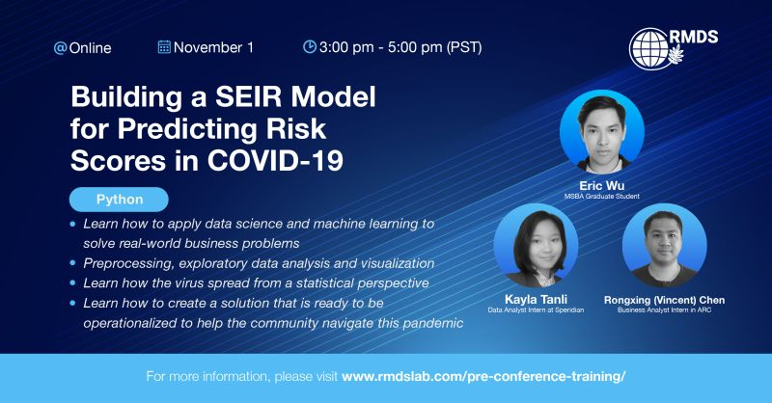

Slide 2


Team LMU MSBA
Loyola Marymount University
Master of Business Analytic Program
Completed RMDS’s data science competition twice

Slide 3
Agenda (time)
Introduction (5 minutes)
Predicting COVID-19 (5 minutes)
SEIR model
Concept (5 minutes)
Model parameters (10 minutes)
Building an SEIR model in Python (Google Colab)
Discussion (15 minutes)

Slide 4
Introduction
COVID-19 originated from Wuhan, China and the first case was identified in December, 2019
Since then, it has spread around the world at an alarming rate
As of the the 25th of October, there have been 42+ million cases
Out of those cases, 1 million of them resulted in deaths.
Symptoms may appear 2-14 days after transmission. These include:
Cough
Shortness of breath or difficulty breathing
Fever
Chills
Muscle pain
Sore throat
New loss of taste or smell

Slide 5
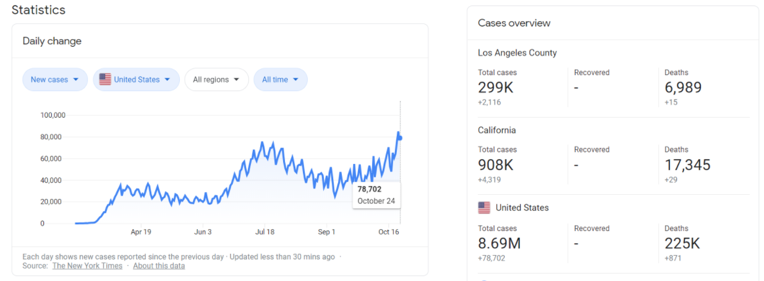
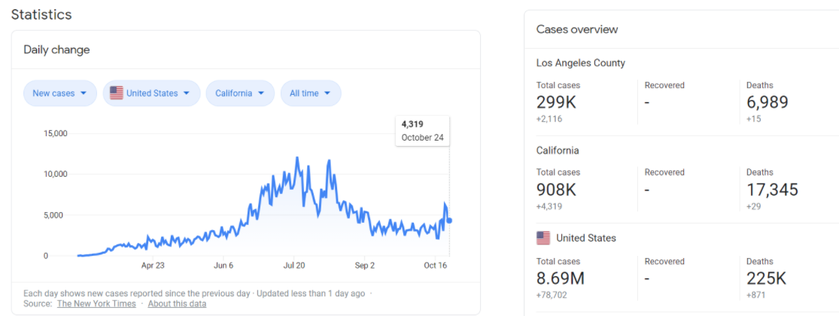
In the United States
Notes:
In the united states, as of October 24, there have been 78,000 new cases. The country, since the start of the Pandemic, has seen 8 milllion cases, the highest in the world
If we zoom in to just california, thye have had 4319 new cases in octover 24. With 299 thousand total cases in los angeles county.
As we see from the Daily change graph in the united states, the numbers have been increasing since the beginning of the september, so there could be a possibility we will be seeing a second wave in cases.

Slide 6
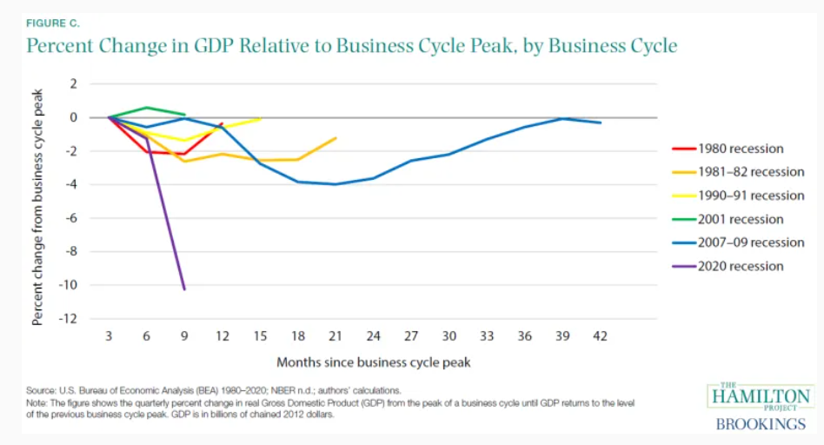
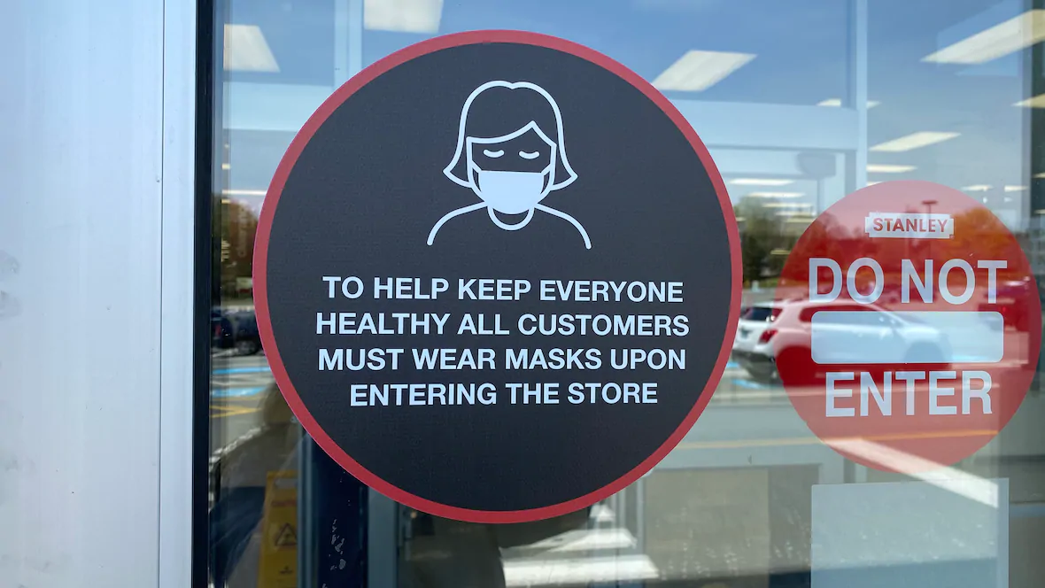
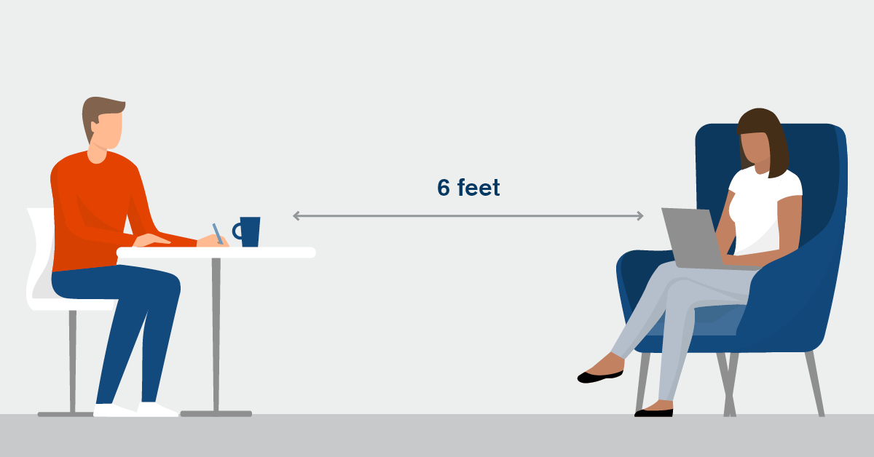
The Effects of Covid-19
Notes:
In addition to the health effects of covid -19, it has impacted the country in different ways. For example, the economy. COVID-19 has caused negative repercussions to not only the United States ecnomy, but the global economy as well. As you can see in the first picture, the percentage change from the business cycle peak in the united states has been not only at its lowest, but it is also the steepes as well compared to other recessions that America has gone through. There have been high rates of unemployment, businesses closing, etc.
Not only did COVID-19 affect the country economically, it did so socially as well. The new norms these days have been to wear masks in order to protect others from contracting COVID (in case you have it) to social distancing 6 feet apart from each other, and having to avoid large crowds of people.

Slide 7
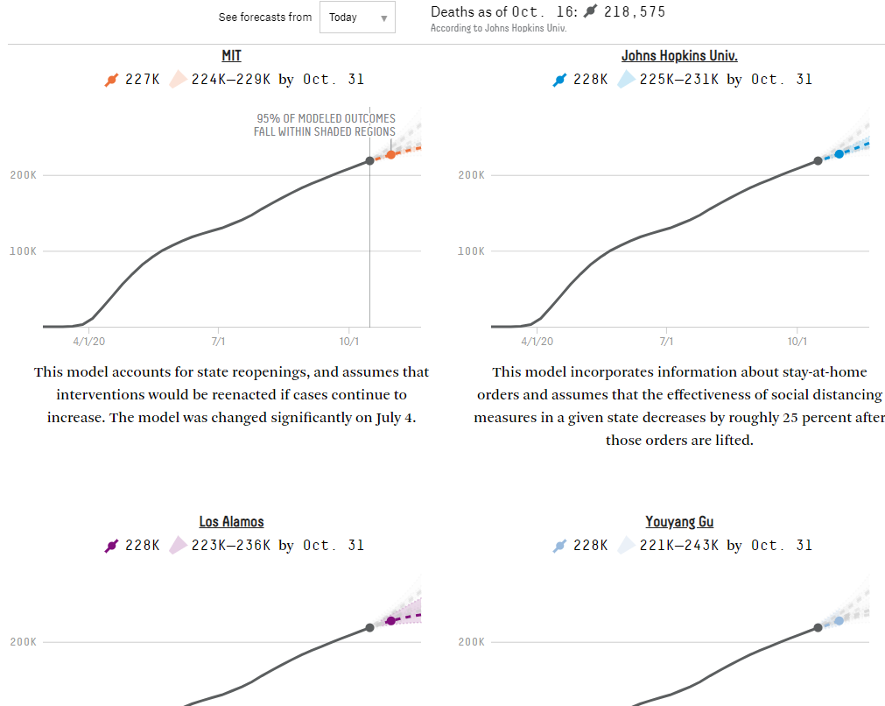
Predicting COVID-19
Source: FiveThirtyEight
Notes:
There have been many models that were made by various institutions to predict COVID-19. Here we can see a model made by MIT which accounts for state reopenings, and assumes intervenations renacted if cases continue to increase. John Hopkins model incorpates info from stay at home orders and assumes the effectiveness of social distaning measures in any state decreases by 25% after the orders have been lifted .In both models you can see an increase in cases, but the rate of increase varies, depdning on the factors taken into consideration.

Slide 8
Prediction Model Objective
To develop a location-based score system that could quantify the risk exposure to the COVID-19
This can help in:
Understanding the bigger picture of COVID-19
Monitoring regional cases
Allocation of resources
Policy-making
Notes:
The objective of our model is to develop a location-based score system that could quanitfy the risk exposure to COVID-19 our hope is that it can help in:
Understanding the bigger picture of COVID-19
Monitoring regional cases
Allocation of resources
Policy-making

Slide 9
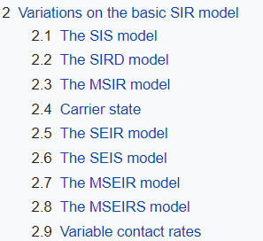
SEIR Model
A variation of SIR model in epidemiology
Incubation period
the time elapsed between exposure to someone who has shows symptoms to exhibiting the symptoms
E: Exposed
Notes:
The difference between SIR and SEIR is the incubation period, he time elapsed between exposure to someone who has shows symptoms to exhibiting the symptoms, hence why there is a letter E in SEIR, which stands for exposed.

Slide 10
4 Groups in the SEIR Model
Susceptible
Exposed
Infectious
Removed
All qualified susceptible individuals
Exposed individuals
100%
Clearly infectious individuals
Recovered individuals
Notes:
S → the fraction of susceptible individuals (those able to contract the disease),
E → is the fraction of exposed individuals (those who have been infected but are not yet infectious),
I → is the fraction of infective individuals (those capable of transmitting the disease),
R → is the fraction of recovered individuals (those who have become immune).

Slide 11

Assumption: Confined Space
Fixed population
No interaction from outside
(not inside)
E.g. Lockdown City
Notes:
From the perspective of epidemiology, a lockdown city is even more strict than a confined space, since it blocks the interaction both externally and internally

Slide 12
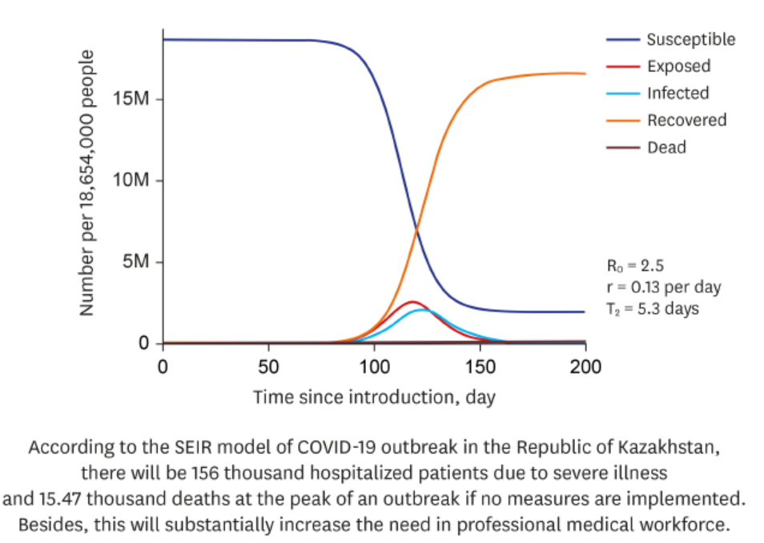
SEIR Model of COVID-19 in Kazakhstan
Source: Journal of Korean Medical Science
https://jkms.org/DOIx.php?id=10.3346/jkms.2020.35.e227
Notes:
Epidemiological Characteristics and Forecast of COVID-19 Outbreak in the Republic of Kazakhstan
The number of people who are able to contract the disease will decrease as time goes by
In turn, the number of recovered will increase.
Those who have been infected but not yet infections will reach a peak, and same will go for the number of those actually infected. This is what they would mean

Slide 13
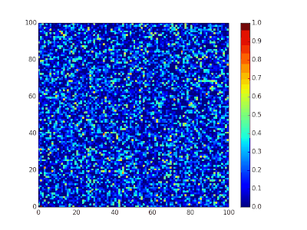
Spatial SIR model simulation
Source: Wikipedia
Notes:
Spatial SIR model simulation. Each cell can infect its eight immediate neighbors, as you can see this is why they tell us to stay away from large crowds and to practice social distancing, because of how fast a disease can spread from one person to another

Slide 14

Parameters
S,E,I,R: Four stages of population
N: Initial total population
t: Time
Factors Excluded:
Birth Rate
Death Rate
Notes:
The parameters we used for our model include the 4 stages of the population: Susceptible, exposed, infectious, and recovered
N → Which is out intital total population
T → which is our time
The factors we excluded are the natural birth rate, and natural death rate.
I will now hand it over to Vincent to dive deeper into the SEIR model, and eventually we will get to coding!

Slide 15
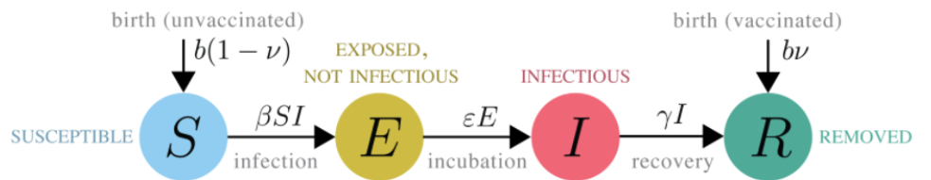
Four Stages in SEIR Model
Beta: Probability of disease transmission
Epsilon: Rate of progression from exposed to infected
Gamma: Recovery rate of infected individuals
Source: The statistics of epidemic transitions
https://journals.plos.org/ploscompbiol/article?id=10.1371/journal.pcbi.1006917

Slide 16
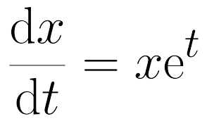
Derivative and Differential equation
Measures the change in values in the smallest unit (Slope)
Reflects how much values are changing
E.g. dx/dt = 1
t=0, x = 1
t=1, x = 2
t=2, x = 3
E.g. dx/dt = x
t=0, x = 1
t=1, x = 2
t=2, x = 4

Slide 17
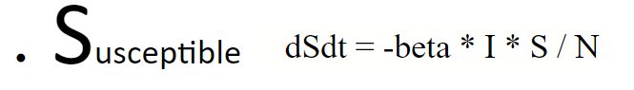
Susceptible Formula
Change in S in time t
(To E)
Prob for disease transmission
# of Infectious sources
Chances of making an infectious contact

Slide 18
Exposed Formula
Change in E in time t
Population getting exposed to infection (from S)
Population getting infectious
(To I)
Notes:
Incubation period

Slide 19
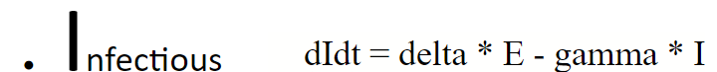
Infectious Formula
Change in I in time t
Population getting infectious
(from E)
Population getting recovered
(To R)

Slide 20
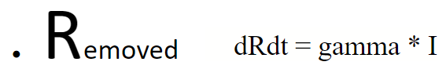
Removed Formula
Change in I in time t
Population getting recovered
(From I)

Slide 21
Recap
Susceptible
Exposed
Infectious
Removed
dS/dt = -beta * I * S / N
dE/dt = beta * I * S / N - delta * E
dI/dt = delta * E - gamma * I
dR/dt = gamma * I

Slide 22
It is coding time!
Download and save as ipynb file
Highly suggested using colab by only visiting the website
You may need to set up an account
Code Link:
https://github.com/qazwer564/Public-files/blob/main/SEIR_workshop.ipynb

Slide 23
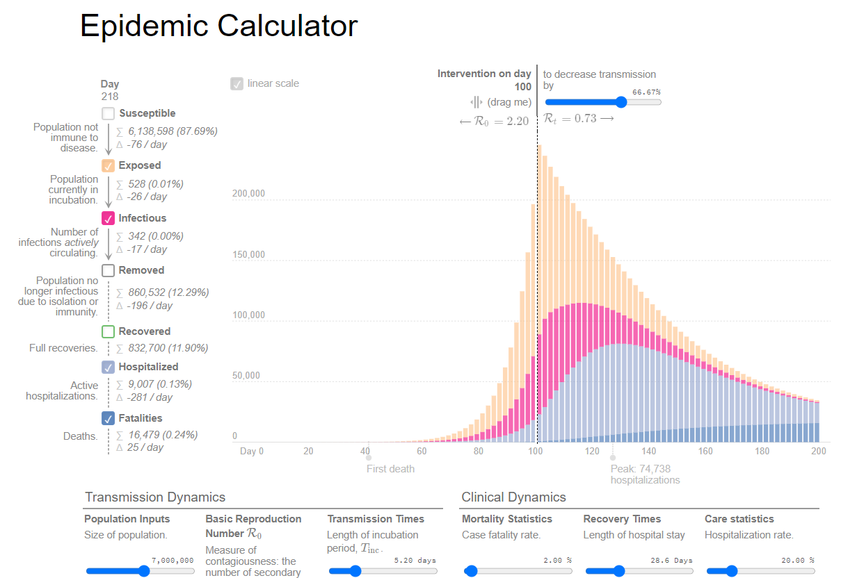
Play it yourself!
https://gabgoh.github.io/COVID/index.html

Slide 24
Short term vs Long term
Short term
Virus diffusion pattern is stable
Parameters are not changing
Long term
Parameters might change
A static model wouldn’t work for long term
But it could provide clues from variations
Notes:
The prediction should look great because, in the short-term, the virus diffusion pattern should be relatively stable. Thus, SEIR can capture the pattern and make predictions based on the revealed pattern pretty well because the model is educated by the epidemic theory.
In the beginning, it "overestimates," but this is more likely that there is no enough testing capacity in the early stage, and the reported cases are probably underestimated rather than our model overestimates. If so, we could conclude that model educated by epidemic theory might give us a more educated guess of the reality than the "observed" data do. In the later stage, the model underestimates; this is more likely that the underlying diffusion pattern changed, i.e., the virus spreading at an accelerating speed due to the factors mentioned above.

Slide 25
Solution
A Dynamic model
Target: Reproduction number (R_0)
Average number of people infected from one other person
R_0 = Beta / Gamma
See the attached R file for the implementation
https://github.com/qazwer564/Public-files/blob/main/SEIR_workshop/LA%20County%20Covid19%20Prediction.R

Slide 26
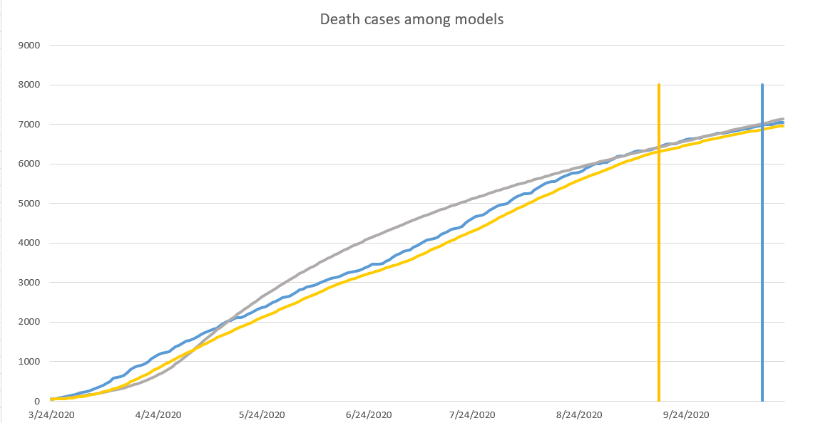
Death cases
Blue: Actual Deaths
Gray: Predictions
Orange: Base model
Training Set
Validation
Set
Test Set

Slide 27
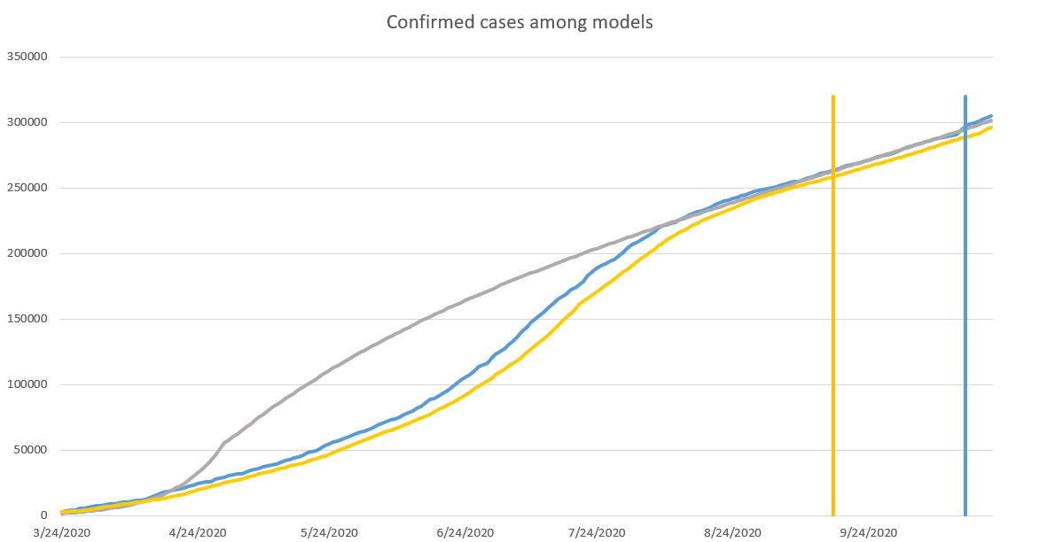
Confirmed cases
Blue: Actual Cases
Gray: Predictions
Orange: Base model
Training Set
Validation
Set
Test Set

Slide 28
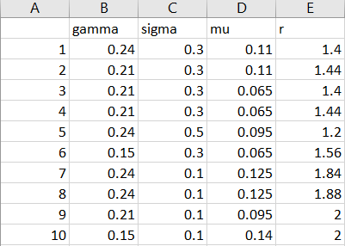
Training
Train models with training set and validation sets
Define loss function and calculate losses
Select 10 best performed models
Get an weighted average result from the results of the 10 models
Weight is decided by the loss values
Make predictions for the future
See files from https://github.com/qazwer564/Public-files/tree/main/SEIR_workshop

Slide 29
Flowchart
SEIR model
Predicted Total
Increments
Region distribution
Risk Map
Periodic
Updates
Area specs
Mobility Data: Google, Apple
Demographic data: Census Bureau
Hospital data: CHHS
Notes:
CALIFORNIA HEALTH AND HUMAN SERVICES OPEN DATA PORTAL

Slide 30
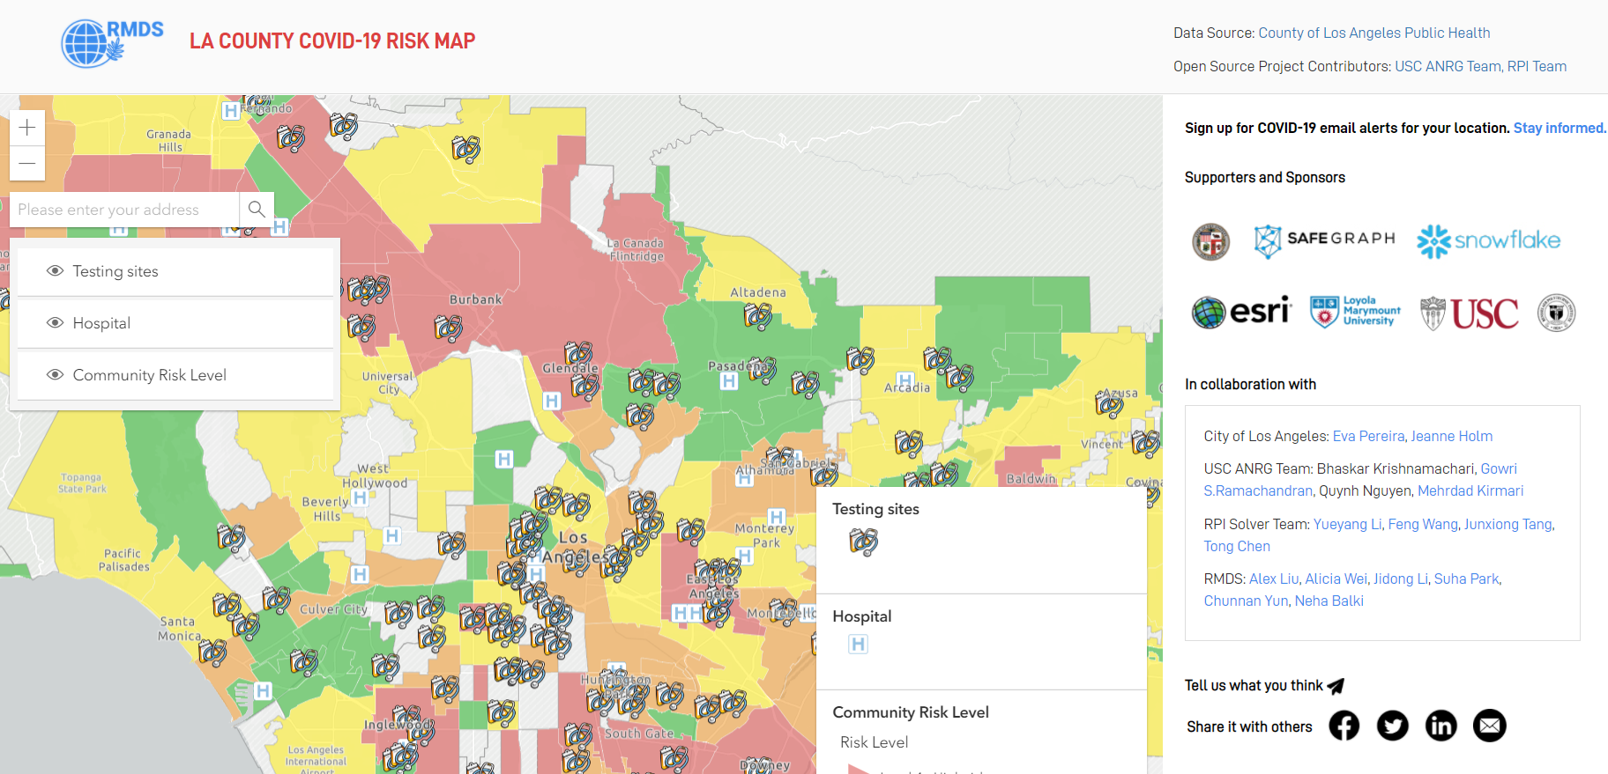
RMDS risk map
Source: https://grmds.org/risk/

Slide 31
Policy making
City lockdown
Business shut down
Restaurants
Barber Shops
etc...
Allocation of Medical resources
Hospitals and beds
Medicines
Doctors and Nurses
Masks
etc...

Slide 32
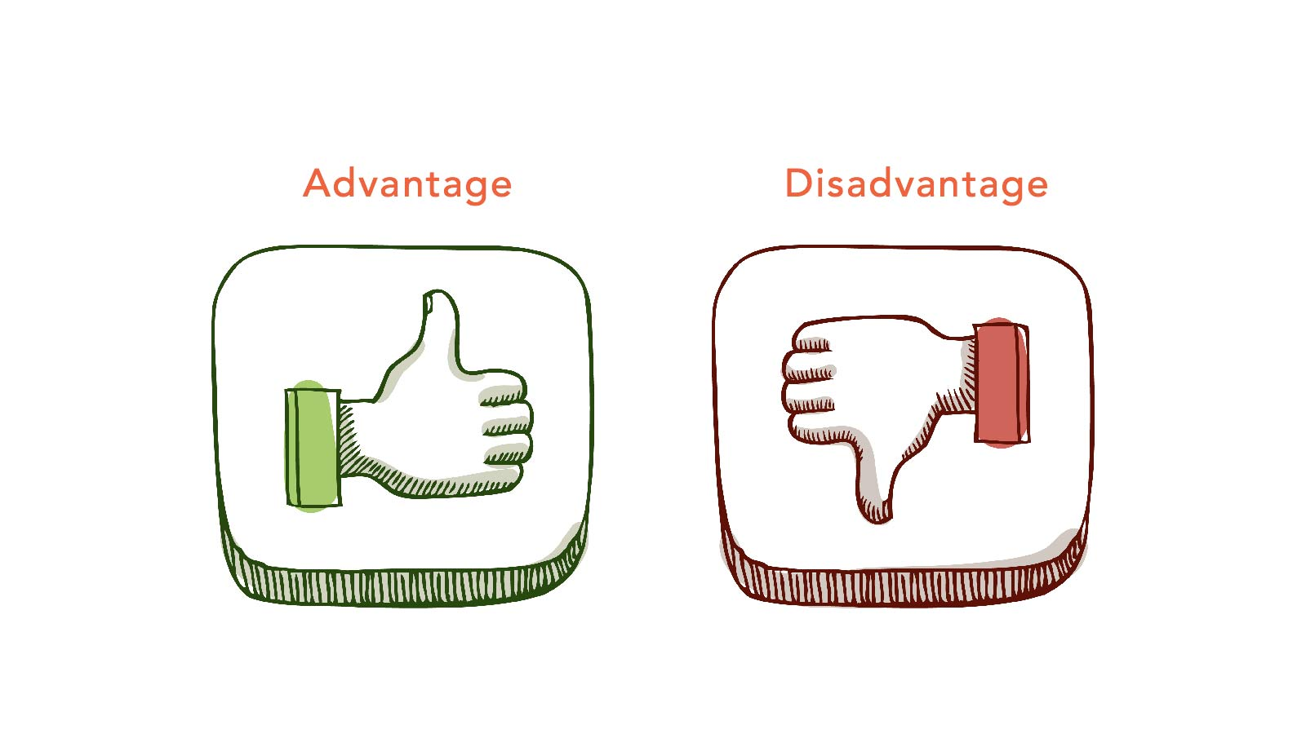
Advantages
Easy to understand
Convenient for simulation
Open for modification
Disadvantages
Confined space too ideal
Parameters changing over time
Ignoring natural birth rates and death rates

Slide 33
Model Improvements
Consider the birth rate and death rate
Change the parameters within time: events
lockdown/reopen
BLM march
Presidential selection
Etc…
Add Hospitalization

Slide 34
Takeaways from SEIR
Context matters
COVID-19 is not only an epidemic issue
Theory matters
SEIR performed well for it is educated by epidemic theory
Analysts' decision matters
Make parameters dynamic to help SEIR work better

Slide 35
Summary
SEIR Concepts
SEIR Parameters
Building an SEIR model
Applications
Improvements

Slide 36
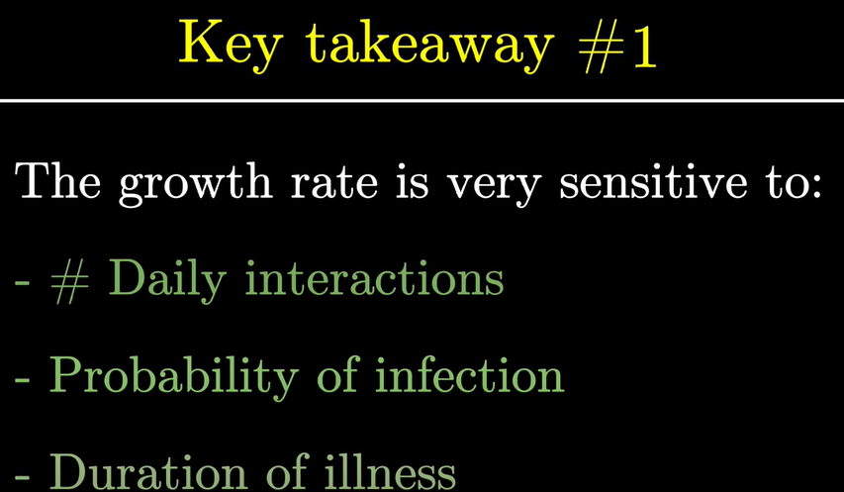
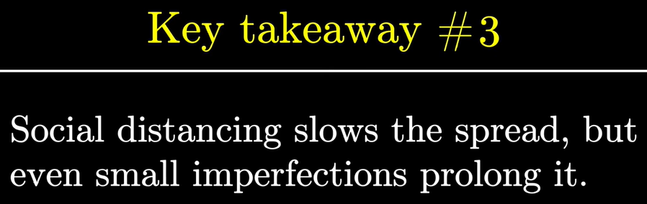
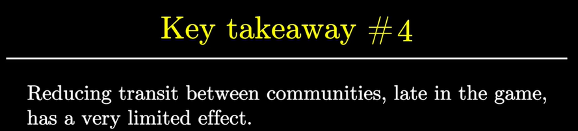
SIR model simulation
https://www.youtube.com/watch?v=gxAaO2rsdIs&feature=emb_logo&ab_channel=3Blue1Brown

Slide 37
Four stages in SEIR Model
Susceptible
Exposed
Infectious
Removed
Total population
All possible Exposed individuals
Already infectious individuals
Recovered or deceased individuals

Slide 38

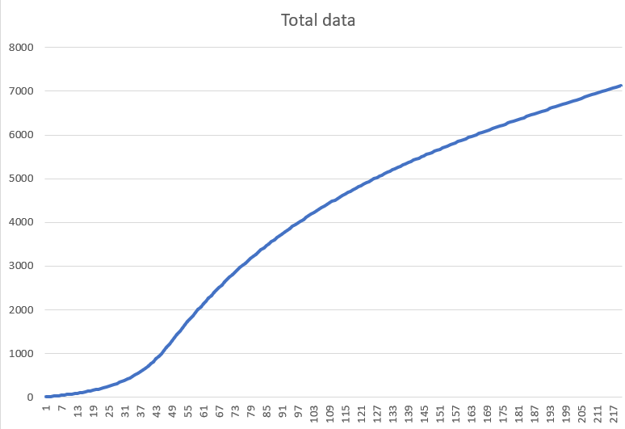
Training Set
Validation
Set
Test Set

